Slide 1

Azure Overview | Partner Enablement
Mr. Salin Kumar
Sr. Pre-Sales Consultant - Microsoft Cloud
Redington Middle East and Africa

Slide 2
Microsoft Azure Cloud
Global Trusted Hybrid

Slide 3
What is a “Cloud”?
Cloud: on-demand, scalable, multi-tenant, self-service compute and storage resources
Server Provisioning
Cloud Provisioning
Demand
Demand
Time
Overprovisioned
Time
Underprovisioned

Slide 4

Cloud: Efficiency Versus Control
Microsoft Azure
= Managed for You | Standalone Servers | IaaS | PaaS | SaaS
Applications
Runtimes
Database
Operating System
Virtualization
Server
Storage
Networking
Efficiency
Control+Cost

Slide 5
Cloud Terminology
Infrastructure as a Service (IaaS): basic compute and storage resources
On-demand servers
Amazon EC2, VMWare vCloud
Platform as a Service (PaaS): cloud application infrastructure
On-demand application-hosting environment
E.g. Google AppEngine, Salesforce.com, Windows Azure
Software as a Service (SaaS): cloud applications
On-demand applications
E.g. Office 365, GMail, Microsoft Office Web Companions

Slide 6

IaaS
Developer
5) Configure load
balancer
1) Choose image, then create VM for DBMS and configure DBMS
2) Choose image, then create and configure VM(s) for application
3) Provision database, then create tables and add data
4) Install application
6) Manage VMs and DBMS (e.g., deploying new OS images in VMs)
Library
VM Images
Data
Application
Web
Server
Load Balancer
DBMS
Operating
System
Operating
System
Operating
System
VM
VM

Slide 7
PaaS
Developer
1) Provision database, then create tables and add data
2) Deploy application
Data
Application
Web
Server
Load Balancer
DBMS
Operating
System
Operating
System
Operating
System
VM
VM

Slide 8

Azure services everywhere
55 Azure regions
10,000s of service providers
100,000s of enterprises

Slide 9


Slide 10

Microsoft Azure
Move Faster
Save Money
Hybrid Consistency
$

Slide 11
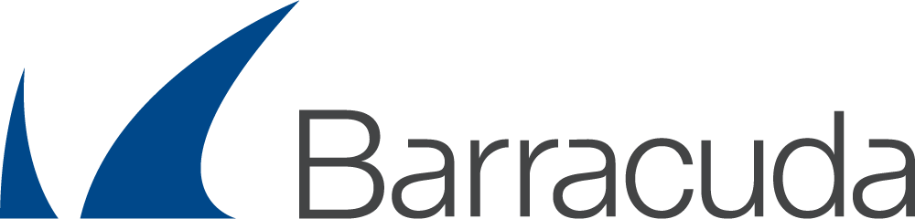

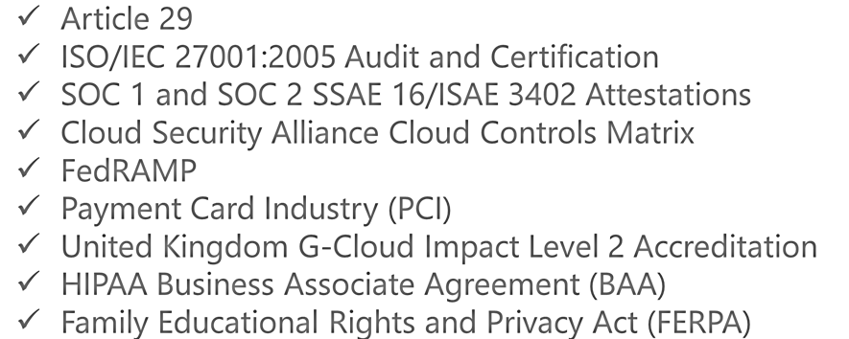

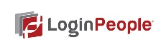

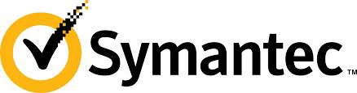

Virtual Networks
Forced Tunneling
RBAC
Multiple vNICs
IP ACLing
Subnet ACL’ing
Trust and Control

Slide 12




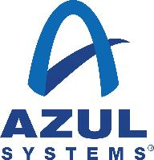
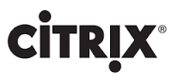
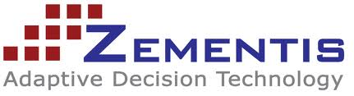

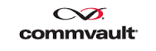






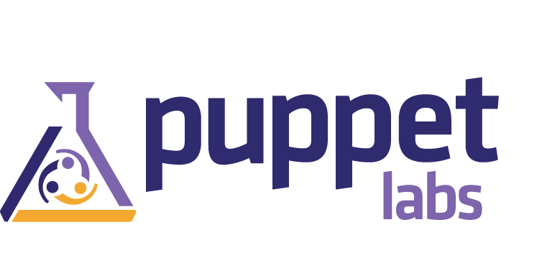















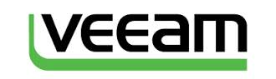




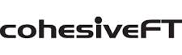








A Growing Marketplace

Slide 13
Security Partnerships

Slide 14
pay only for what you use
→

Slide 15
no upfront costs

Slide 16

per minute billing

Slide 17
no charge for stopped VMs
$

Slide 18
Resource Groups:
Resource groups (RG) in Azure is a new approach to group a collection of assets in logical groups for easy or even automatic provisioning, monitoring, and access control, and for more effective management of their costs.

Slide 19
DEMO

Slide 20
Virtual Networks(Vnet):
Azure Virtual Network (Vnet) is the fundamental building block for your private network in Azure. Vnet enables many types of Azure resources, such as Azure Virtual Machines (VM), to securely communicate with each other, the internet, and on-premises networks. Vnet is similar to a traditional network that you'd operate in your own data center, but brings with it additional benefits of Azure's infrastructure such as scale, availability, and isolation.

Slide 21
DEMO

Slide 22
Network Security Groups:
You can filter network traffic to and from Azure resources in an Azure virtual network with a network security group. A network security group contains security rules that allow or deny inbound network traffic to, or outbound network traffic from, several types of Azure resources.

Slide 23
DEMO

Slide 24
Azure Disk Storages:
Difference Between Managed Disks and Unmanaged Disks. In unmanaged disks, you have to create storage accounts to hold the disks (VHD files) for your Azure VMs. With Managed Disks, you are no longer limited by the storage account limits.

Slide 25
Azure Storages:
Azure Storage is Microsoft's cloud storage solution for modern data storage scenarios. Azure Storage offers a massively scalable object store for data objects, a file system service for the cloud, a messaging store for reliable messaging, and a NoSQL store.
Azure Storage includes these data services:
Azure Blobs: A massively scalable object store for text and binary data.
Azure Files: Managed file shares for cloud or on-premises deployments.
Azure Queues: A messaging store for reliable messaging between application components.
Azure Tables: A NoSQL store for schemaless storage of structured data.

Slide 26
DEMO

Slide 27
Azure Virtual Machines:
Azure Virtual Machines (VM) is one of several types of on-demand, scalable computing resources that Azure offers. ... You pay for extra VMs when you need them and shut them down when you don’t.

Slide 28
DEMO

Slide 29
Azure Virtual Network Gateways(VPN):
A VPN gateway is a specific type of virtual network gateway that is used to send encrypted traffic between an Azure virtual network and an on-premises location over the public Internet. You can also use a VPN gateway to send encrypted traffic between Azure virtual networks over the Microsoft network.

Slide 30
DEMO

Slide 31
Azure Price Calculator:
Azure pricing online calculator will Configure and estimate the costs for Azure products.
https://azure.microsoft.com/en-us/pricing/calculator/

Slide 32
DEMO

Slide 33
Safeguarding Your Data with a BCDR Solution

Slide 34
Impacts of disruptions on your business
Studies show organizations experience up to four disruptions/year
Costs are staggering: up to $1.5 million per hour
Bigger, longer-lasting impacts if production, compliance are affected

Slide 35
Azure can help safeguard your data and applications
Azure-based disaster recovery solution minimizes disruption impacts
Recovery within minutes, with near-zero data loss
We handle disaster recovery complexity, so you can focus on other priorities
Solution supports heterogeneous/ hybrid hosted IT environments

Slide 36
How Azure solution addresses Disaster Recovery challenges
Ensuring business continuity
Our hosted, Azure-based solution minimizes impacts of disruptions and gets you back in business in minutes, with near-zero data loss.
Managing complexity
Let our experts handle disaster recovery complexity, so your employees can focus on high-impact activities.
Reliable solution
Our solution is based on rigorously tested Azure Site Recovery. ASR is used by organizations worldwide to protect their business-critical data and apps.
Managing large datasets
Our solution is built from the ground up to safeguard high-volume data.
Staying in compliance
Test without affecting production workloads, and be confident you’re meeting compliance objectives.

Slide 37
Migrate Applications to Azure
Key Considerations
Replicate
Test
Migrate
Plan
Plan the Azure infrastructure
Replicate data to Azure
Test applications in Azure before migration
Reduce downtime of production workload during migration

Slide 38


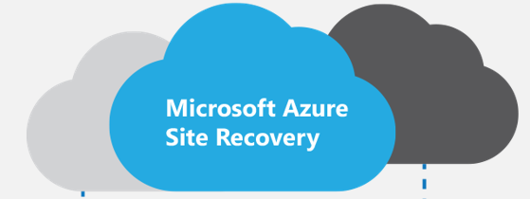

Migrations offering from CSP Partners
Assessment
Migrate
Manage
Portfolio Assessment, TCO Analysis, Security Requirements. Application Dependency Mapping
Create Azure environment. Replicate via ASR, POC, Integrate applications and networks, User Acceptance
Billing, Support, Monitoring…

Slide 39
Azure Site Recovery Architecture

Slide 40
Deployment Planning
Estimate network bandwidth required for initial and delta replication
Identify Azure storage type (standard or premium) required for virtual machines
Estimate the total number of standard and premium storage accounts that need to be provisioned
Estimate the total number of Configuration and Process Servers that need to be deployed while protecting VMware workloads
Virtual machine eligibility assessment based on number of disks, size of the disks and IOPS
Profile the actual churn on the source virtual machine without any impact to the production workload

Slide 41



Migrate VMware and Physical Servers to Azure
Config Server
Process Server
OMS Site Recovery
Microsoft Azure
Data Channel
Source: VMware VMs & Physical Servers
Process Server
Used for caching, compression, and encryption
Configuration Server
Used for centralized management
Mobility Service Captures all data writes from memory

Slide 42

Migrate Hyper-V to Azure
Hyper-V Server
OMS Site Recovery
Microsoft Azure
Data Channel
Source: Hyper-V VMs
Microsoft Azure Recovery Services Agent
Replicates data to Azure

Slide 43


Migration using Site recovery & Azure Migrate
Value Props
Migrate from multiple environments
VMware, Hyper-V, physical, Azure and Amazon Web Services
Migrate any workloads
Support for both Linux and Windows workloads
No-impact migration testing
When replicating workloads into Azure, execute tests to ensure readiness

Slide 44
Migration using Site recovery & Azure Migrate
Value Props
Move applications with near-zero downtime
Move a single application or an entire datacenter to the cloud with minimal impact to production users
No Licensing Fee
No Site Recovery charges for Migration (first 31 days)
HUB (Hybrid Use Benefit)
Move Windows Server licenses covered under Software Assurance to Azure

Slide 45

Application DR with ASR
Azure Site Recovery
DR Orchestration
DR Orchestration
DB Tier
IaaS VM
SQL Availability Group
App Tier
Web Tier
ASR Replication
Azure Storage
Active Directory
AD & ASR Replication
IaaS VM
S2S VPN
Azure
Primary Site

Slide 46
Managed services for migrated workloads - BCDR

Slide 47



Azure IaaS VM backup
“Optimally protect your cloud data”
No backup infrastructure
Self Service Backup/Restore
Application consistent
VHD and VM config backup
Simplified Management and monitoring
Linux
SQL Server
Premium Storage
Virtual Machines

Slide 48

Azure Backup
Simple and reliable cloud integrated backup as a service
Compelling cloud-based backup alternative to tape
Secure and reliable backup as a service
Efficient and flexible online backup services
Azure
Azure
Agent F
Azure Backup
Virtual Machines
State / Config
Commvault Simpana
Azure Storage (blob)
Virtual Machines
VPC / tenant
Restore
VPC / tenant
Restore
Option 1 – Use native Azure Backup
Option 2 – Use 3rd party backup apps

Slide 49
DEMO

Slide 50
Azure File Sync:
Microsoft Azure has an offering called Azure File Sync, which allows the synchronization of on-premises file servers with Azure Files supported by Storage Accounts. There are several benefits of using this approach — it could be used for transition between on-premises and cloud, backup, and disaster recovery.

Slide 51
Azure File Sync:
Azure File Sync can be used as a transition tool to move file server data to the cloud, but also as a synchronization tool to keep more than one server synchronized without the use of DFS or any other replication technology. We can leverage the cloud and use tiering, where unused files on the local file servers can be moved to Azure Files and a local reference of the file stays locally.

Slide 52
Questions?

Slide 53
Thank you

